Slide 1
Face Mask Detection
Using OpenCV, Tensorflow/Keras and Deep Learning.

Slide 2
Introduction
Face Mask Detector is Deep Learning based python program which detects whether a detected person is wearing mask or not
We will be using OpenCV, Tensorflow, Keras Modules and Transfer Learning concept.

Slide 3
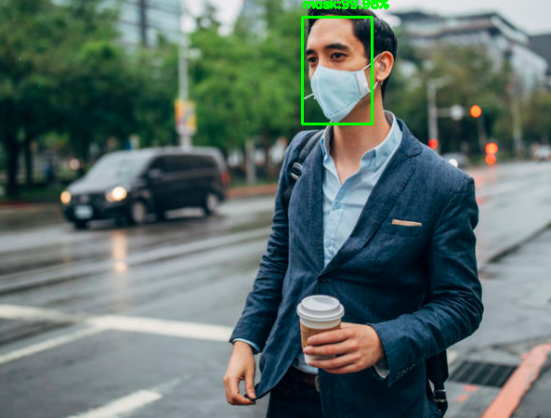

Slide 4
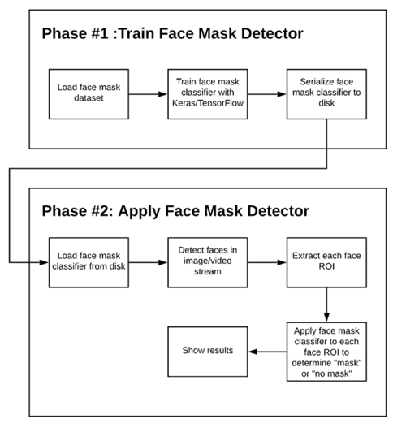
How this project works?

